Slide 1



By KGSI/Molex SAP Team

Slide 2

Agenda
Technical Team Introduction
Growth Transition
Ongoing Projects
Key Achievements / Value Addition
Team Growth
Current Process / Improvement Area
Challenges
Q&A

Slide 3


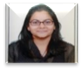





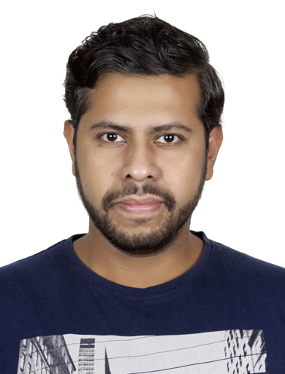
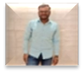
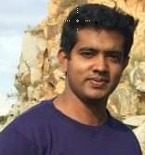
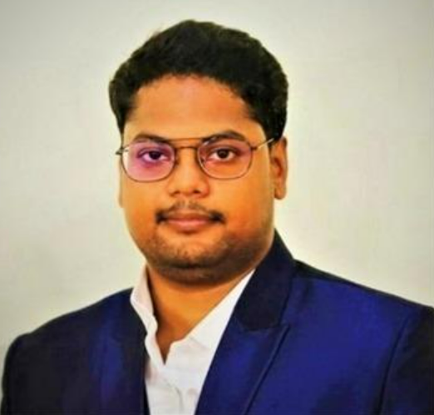


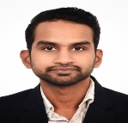
KGSI Molex Technical Team
Manager
Ponraj Sundarraj
Team Lead
Team Lead
Team Lead
Rabi Kiran
Netal
Parth Patel
Gokul Raj
Pranab
Ajay
Akshay
Aavil
Kiran RJ
Nirmal
Abhineet
Sai Ram
Kiran Ramanna
Aayush
+2 SAP Technical Contractor supporting Incidents

Slide 4
Growth Transition
2016
MII
2017
MII, ABAP
2018
MII, ABAP, GTS
2019
MII, ABAP, GTS, PLM
2020
MII, ABAP, GTS, PLM/EHS, BPC, HCM
2021
MII, ABAP, GTS, PLM/EHS, BPC, Functional, HCM
2022
MII, ABAP, GTS, PLM/EHS, BA, HCM, Payroll

Slide 5
Growth Transition
2016
2017
MII
ABAP
2018
2019
2021
2020
2022
ABAP/UI
GTS
PLM/EHS
BA
HCM
Payroll
MII
MII
ABAP
GTS
MII
ABAP
GTS
PLM
MII
ABAP
GTS
PLM/EHS
BPC,
HCM
MII
ABAP
GTS
PLM/EHS,
BPC,
Functional
HCM
YoY Competencies

Slide 6
Molex SAP Technical Capability
ABAP
GTS
PLM/EHSM
Payroll HCM
App Dev
SAP ABAP
ABAP – ECC, the heart of Molex , all business transactions revolves around ECC . ABAP supports the development of new business process, mergers and customization ..It’s used to generate Reports, Data Interfaces, Print Forms(Orders,Invoices), customize business operations and to Print Labels
SAP Global Trade System (GTS)
Global trade services is a system used by Molex for import and export trade processes. SAP GTS provides electronic filing of declarations, product classification, preference determination, letter of credit processing and electronic compliance reporting
.
SAP UI / Fiori App Development
They evaluate business needs to develop and support various mobile applications to perform specific business processes aiming to provide coherent user experience for users .
SAP Product Lifecycle Management (PLM)
SAP PLM helps Molex to develop new products and bring them to market quickly from beginning of life cycle with product ideation to manufacturing , sales & service and finally retire
Payroll & HCM
HCM is a module which deals with the entire life cycle of an employee i.e. Hire to Retire, in an organization.
It provides innovative solutions for core HR , payroll & Other benefits
SAP Environment Health & Safety (EHS)
SAP EH&S helps to generate compliance certificates for customers to mitigate the risk of hazardous substances and limits the import and export of chemicals. It’s tools manage occupational/ product safety processes and corporate responsibility.

Slide 7




Projects – Ongoing and Future
JCT
Global Support
Fusion Opcenter & Fusion PD
MPS
GTS SP21 Upgrade / Client Split
LoftWare
Project Neo Post Go-live & PCN 2.0
Molex HR Sunset

Slide 8

Achievements
TPP By harnessing our comparative advantage and demonstrating accountability, KGSI team successfully implemented the TP Model for domestic sales in its SH and China plants, achieving substantial tax savings of $2 million.
Project Neo
The Future State Architecture of Molex.com envisions a unified user experience by integrating content, commerce, community, and enablement through "headless" service providing systems.
Redwood
KGSI Team self-actualized in Redwood-RunMyJob. The project successfully migrated SAP jobs improving system performance. The support model implemented with effective alerting and reporting capabilities in ServiceNow.

Slide 9

Initiative / Value Addition
3PL validation
Calendar Upload
Updating file path for EDI
Business Process Knowledge Sharing

Slide 10

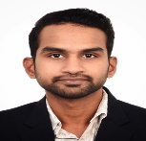
Team Self-Actualization Journey
Reskilling in ABAP by 2 Non-SAP resources
Opportunity to fill Open roles quickly
Opportunity for Non-SAP employees to move to SAP
Adding capability of Mobile Application development by upskilling
on SAP Fiori & UI5 concepts by 2 ABAP resources and 1 Intern
Opportunity to work in CAP dev and Migration of existing
Applications.
Upskilling in BTP -
Prepared to work on BTP developments .
Opportunity to suggest recommendations on tools, Software and
implementation strategies.
Various knowledge sharing sessions within team on new business process
such as GTS / PLM and EHS thereby enabling cross skilling of the team .

Slide 11
Team Self-Actualization Journey
Certification
S/4 HANA Experience
Parth Patel
SAP S/4 HANA 1610
Netal Chauhan
SAP BTP Extension Developer,
SAP Fiori Application Developer,
ABAP for HANA 2.0
Gokul Raj
ABAP for HANA 2.0
Rabi Kiran Sahu
ABAP with SAP Netweaver 7.41
Rabi Kiran Sahu
SAP S/4 HANA 1805/1902
Akshay Rajkumar
SAP S/4 HANA 2021
Gokul Raj
Business suite on HANA
Team Enthusiasm

Slide 12

Team Readiness - Contribution
BTP / UI Developments
Prepared to work on BTP developments.
Adding capability of Mobile Application development by upskilling on SAP Fiori & UI5 concepts by 2 ABAP resources and 1 Intern Opportunity to work in CAP dev and Migration of existing Applications.
Opportunity to suggest recommendations on tools, Software and implementation strategies.
HANA
5 Resources have work experience and knowledge.
Non-SAP to SAP Consultant
One resource is actively supporting in APN related developments.
Another resource is part of GTS developments.

Slide 14
Team Self-Actualization Journey
Certification
S/4 HANA Experience
Parth Patel
SAP S/4 HANA 1610
Netal Chauhan
SAP BTP Extension Developer,
SAP Fiori Application Developer,
ABAP for HANA 2.0
Gokul Raj
ABAP for HANA 2.0
Rabi Kiran Sahu
ABAP with SAP Netweaver 7.41
Rabi Kiran Sahu
SAP S/4 HANA 1805/1902
Akshay Rajkumar
SAP S/4 HANA 2021
Gokul Raj
Business suite on HANA
Team Readiness
Team members upskilled on S/4 HANA with the help of GP technical team.
Team members also performed hands on exercises in sandbox servers.
Developers shared the knowledge with team on their learning and challenges.

Slide 15
Value Addition
Problem Statement:
The current process is the time-consuming coordination required among multiple teams (SAP, EDI, 3PL, and BA) to identify and resolve corrupted data in the EDI file.
This involves SAP team checking logs or debugging the job, EDI team locating the file, and 3PL team resending the file to Molex.
The delay in resolving the issue impacts the timely completion of goods movement, picking, packing, and obtaining acknowledgments, leading to a standstill in the overall process.
Solution:
The proposed solution reduces the SAP/EDI team's involvement in recurring issues by implementing additional validation and sending email notifications to stakeholders for incorrect data identified by the 3PL.
Sharing directory paths with the EDI team enables prompt action on reported issues, while resending files remains essential. This minimizes warehouse disruptions and decreases dependency on the EDI/ABAP team.
Value Addition:
Improved efficiency and minimized warehouse disruptions.
Decreased SAP/EDI team involvement with immediate 3PL and BA notifications for prompt action on incorrect data.
Streamlined communication by sharing interface information with the EDI team.
Faster problem resolution with timely 3PL action.

Slide 16
Improvements and Current Process
We have initiated effective communication with business analysts (BAs) and end users, clearly stating expected completion dates with input from the most senior code reviewer. This approach ensures transparency and collaboration among all stakeholders involved.
We are fostering a model that includes developers in all technical areas, providing opportunities for self-actualization and personal growth for everyone.
Our focus is not solely on ABAP development but on projecting ourselves as SAP Technical Developers. This mindset shift is crucial to adapt to evolving SAP technologies and keep up with the pace of the Business Technology Platform (BTP). It also encourages developers to excel in SAP BTP, HANA, and UI technologies.

Slide 17

Improvements and Current Process
Effective communication with BAs and end users
Clear expectations and completion dates
Input from senior code reviewer
Transparency and collaboration among stakeholders
Inclusive model for developers
Opportunities for self-actualization and personal growth
Developers in all technical areas
Mindset shift to SAP Technical Developers
Not solely focused on ABAP development
Adapting to evolving SAP technologies
Keeping up with the pace of Business Technology Platform (BTP)
Encouraging developers to develop skills in these areas

Slide 18
Support Model – A Comparative Advantage
In-house technical expertise ensures swift resolution of complex challenges.
Seamless collaboration and knowledge sharing within the support team.
Improved customer satisfaction with faster issue resolution.

Slide 19
Challenges / Ask from Leadership
The inclusion of GTS Business Analyst (BA) will streamline the process, consolidating requirements into a single request instead of multiple requests.
The testing scope for the requirements has been lacking clarity up to this point. Moving forward, we anticipate having a defined testing scope specifically for Unit testing.
A short validity of Security roles delaying process and developments.
Awareness/Possibility of participation in SAP Technical workshops as needed. (E.g.: Rise with SAP).
Request for S/4 HANA Sandbox.

Slide 20

Challenges / Ask from Leadership
Streamlining Process by including GTS Business Analyst (BA) to consolidate multiple requests into one
Define Testing Scope to reduce ambiguity, specifically for Unit Testing
Address short validity of Security roles delaying process and developments
Explore Participation in SAP Technical Workshops, such as "Rise with SAP.”
Request for S/4 HANA Sandbox

Slide 21

Thank You Molex!!
Participating in the HANA Conversion Boot Camp has been a valuable learning opportunity.

Slide 22


